Slide 1
BUILDING YOUR WINNING TEAM
All Our Dreams Can Come
True If We Have The
Courage To Pursue Them
Walt Disney

Slide 2
THE ONGOING ISSUE!
I Just Can’t Find Good People!
My People Are Driving Me Crazy!

Slide 3
OR IS THE PROBLEM
GOOD PEOPLE CAN’T FIND ME!

Slide 4
WOULD YOU
WORK
FOR YOU?
Paul Radillo
NCSG 1987

Slide 5
YOUR
CULTURE?

Slide 6
YOUR
CULTURE?

Slide 7
CULTURE

Slide 8
ARE YOU HIRING OR
ARE YOU RECRUITING?
NEVER HIRE AGAIN
YOU HIRE FOR A JOB
YOU RECRUIT FOR A CULTURE
ALWAYS RECRUIT

Slide 9
DO YOUR CORE VALUES
AND THEIR CORE VALUES
MESH OR COLLIDE?
TRAIN
VERSUS
RETRAIN

Slide 10
WHEN DO YOU LOOK
HOW DO YOU LOOK
WHERE DO YOU LOOK
HOW DO YOU CULL

Slide 11
GOTTA HAVE
A SYSTEM
SUCCESS IS
A PROCESS!

Slide 12
STEP 1
IDENTIFY YOUR NEEDS
Have you clearly defined your needs in regards people
Can you describe your perfect find
Have you done a “NEEDS ANALYSIS”

Slide 13
BE CLEAR ON WHAT YOU NEED
(JOB DESCRIPTION)
NEVER DESIGN A BUSINESS
BASED ON YOURSELF?
NEVER DESIGN A JOB AROUND A PERSON, BUILD THE POSITION,
RECRUIT FOR THE POSITION
DON’T BUILD A MONSTER?

Slide 14
STEP 2
DEVELOP THE SYSTEM
DEVELOP YOUR MARKETING PLAN
CRAIGSLIST
HELP WANTED AD
PUBLIC STATE EMPLOYMENT OFFICE
PRIVATE EMPLOYMENT OFFICE (HEADHUNTERS)
EMPLOYMENT WEB SITES indeed monster careerbuilder
FACEBOOK
COMPANY WEBSITE
YOUTUBE
VETERANS PROGRAMS

Slide 15
MILITARY VETERANS
THEY CAN’T FIND YOU
YOU CAN’T FIND THEM
THE ONES YOU WANT!
THEY COMPLETE THEIR TERM
THEY GET MEDICALLY RETIRED
THEY GET REMOVED DUE TO LEGAL ACTION
THEY GET A FULL 20 YEAR RETIREMENT

Slide 16
MILITARY CONTACTS
THROUGH STATE EMPLOYMENT OFFICE
LVER / LOCAL VETERANS EMPLOYMENT REPRESENTATIVE
DVOPS / DISABLED VETERANS OUTREACH PROGRAM SPECIALISTS / DO NOT LET THE WORD DISABLED SCARE YOU HERE
REMEMBER / MILITARY RETIREES HAVE A RETIREMENT INCOME OFTEN RETAINING 50% EARNINGS FROM MILITARY

Slide 17
PRIVATE EMPLOYMENT AGENCIES
HEADHUNTERS
OUTSOURCE FOR
EXPERTISE

Slide 18
TELL ME
WHY WOULD I WANT TO
WORK FOR YOU?
IT IS JUST LIKE MARKETING YOUR
SERVICES & PRODUCTS
SELL ME YOU
TELL ME YOUR STORY
GIVE ME YOUR ELEVATOR SPEECH

Slide 19
IT IS A FORM OF
SALES & MARKETING
SELLING THE COMPANY
BUILDING A RELATIONSHIP
ENGAGING THE PROSPECT
REMOVING THE PERCEIVED RISKS

Slide 20
PROSPECT PROFILE
ASK / FIELD TRIPS
PERSONAL RESEARCH
FIND SOMEONE WHO FITS YOUR PROFILE
ASK THE QUESTION
“IF YOU WERE LOOKING FOR EMPLOYMENT
WHERE WOULD YOU LOOK”?
LEAVE THEM A CARD
“KNOW SOMEONE LIKE YOU WHO WANTS A
CAREER, TELL THEM TO GIVE ME A CALL”

Slide 21
WELL YOU CAN WALK
AND YOU CAN TALK
YOU CAN ADD 2 PLUS 2
YOU ARE HIRED
BIG MISTAKE!!

Slide 22
DO YOU KNOW HOW TO
CONDUCT AN INTERVIEW?
CAN YOU DEVOTE THE
TIME FOR THE INTERVIEW?

Slide 23
CULTURE
YOU GOT TO
GET INSIDE
THE HEAD!

Slide 24
DRILL DOWN
PERSONALITY TESTING
www.wonderlic.com
200,000,000 Served
Personality
Motivation
Integrity
Ability To Learn
Adapt
Solve Problems
Understand instructions

Slide 25
STEP 3
TIME TO DRILL DOWN
OR WATCH YOUR
INVESTMENT TANK!

Slide 26
YOU FOUND YOUR GUY!!
NOW WHAT??

Slide 27
What Is The
Prospect’s Dream?
“YOU WILL GET EVERYTHING
YOU WANT IN LIFE IF YOU
JUST HELP ENOUGH PEOPLE
GET WHAT THEY WANT”
Zig Ziglar

Slide 28
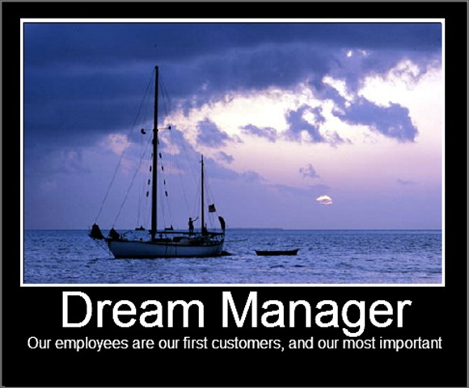
HAVE YOU CONSIDERED
A DREAM MANAGER?
YOUR PEOPLE
HAVE DREAMS
TOO!

Slide 29
EXPECTATIONS
ARE YOU SPELLING
THEM OUT?
WRITTEN GOALS HAPPEN
WRITTEN EXPECTATIONS HAPPEN
30 / 60 / 90
3 / 6 / 9 / 12
1 / 2 / 3

Slide 30
How Is This
Guy Going To
Affect Things?

Slide 31
INSPECT FOR WHAT
YOU EXPECT!

Slide 32
WANT SUCCESS?
STOP BEING THEIR MANAGER
BECOME THEIR COACH
AFTER ALL YOU RECRUITED
THEM FOR YOUR
TEAM
THINK LIKE YOUR PLAYER

Slide 33
GREAT COACHES ARE
GREAT FACILITATORS!
RECOGNIZE YOUR LIMITATIONS
YOU CANNOT BE AN EXPERT
IN EVERYTHING

Slide 34
THE SUCCESSFUL COACH
HAS HIS PLAYBOOK
YOUR PLAYBOOK
STANDARD OPERATING PROCEDURES
THE SECRET TO A TURN KEY BUSINESS

Slide 35
THE SUCCESSFUL COACH
CALLS TIME OUT
5 MINUTE MORNING MEETING
COLLECTING DATA
WEEKLY MANAGERS MEETING
DECIDING STRATEGIES
MONTHLY COMPANY MEETINGS
IMPLEMENTING STRATEGIES

Slide 36
THE SUCCESSFUL COACH
CALLS IN SPECIALISTS
WHO IS ON YOUR A-TEAM?

Slide 37
THE SUCCESSFUL COACH
HAS HIS TEAM IN TRAINING &
CONTINUES THIS ALL SEASON
TRAINING IS AN ON GOING PROCESS
TRAINING MUST BE PLANNED
TRAINING MUST BE BUDGETED FOR
TRAINING MUST HAVE ROI
YEP HE GOT HIS GOOD POINTS.
HE ALSO GOT HIS BAD POINTS!
YOU WANT HIM TO TRAIN YOUR NEW GUY?

Slide 39
RESPONSIBILITY
THE HARDEST THING THERE IS ABOUT
BEING A MANAGER, NO MATTER WHAT
HAPPENS, IT IS YOUR FAULT!
AFTER ALL YOU WERE THE ONE
THAT LET IT HAPPEN!

Slide 40
YOU DON’T HAVE TO BE GREAT TO START?
BUT YOU DO HAVE TO START TO BE GREAT!
Zig Ziglar

