Slide 1
Sign In or Join Now
Charting Your Path to Financial Success
April 20-22, 2015
Patricia Lawrence, CMA
Principal & Consulting CFO

Slide 2
BONUS MATERIAL

Slide 3
Financial Statements
Balance Sheet – cumulative accounts of the company
P&L (Income Statement) – profit/loss over period of time
Cash Flow – where the money comes from/goes to
Cash is King!

Slide 4
Financial Statements
Income Statement (P&L) - measures the profit and loss of a business over a period of time
Revenue
Expenses
Margin/Gross Profit
Operating Income
EBITDA – Earnings before interest, taxes, depreciation, amortization
EBIT – Earnings before interest & taxes
Net Income/Loss

Slide 5
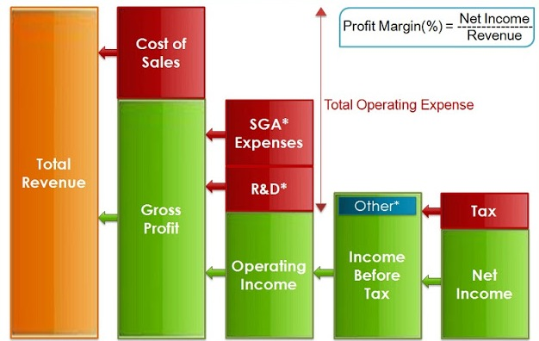
Financial Statements
Interest
Depreciation
Amortization
EBITDA EBIT

Slide 6
Financial Statements
Balance Sheet – cumulative accounts of the company
Assets
Liabilities
Owner’s Equity

Slide 7
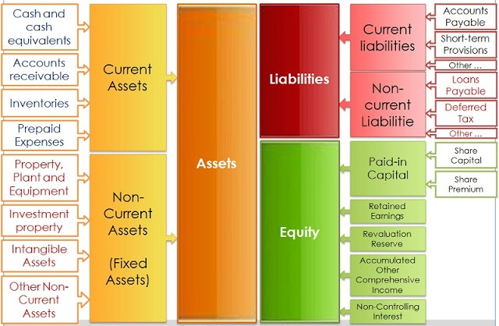
Financial Statements

Slide 8
Financial Statements
Cash Flow – where the money comes from and goes to
Operating Activities
Investing Activities
Financing Activities

Slide 9
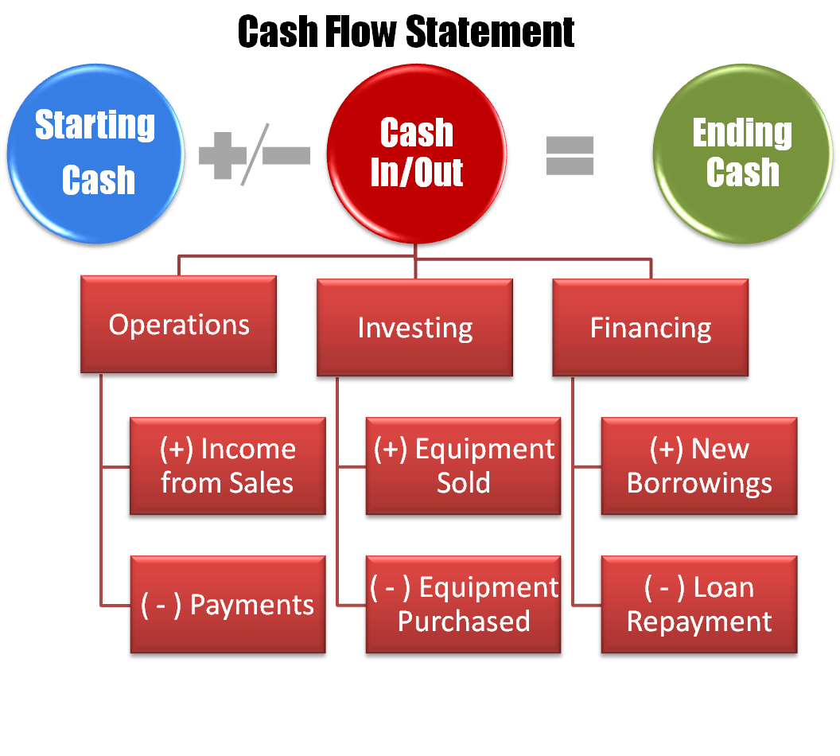
Financial Statements

Slide 10
Financial Statements
Cash Flow
vs
Profit
Concerns the movement of money into and out of the business
Functions as the “gas” in your business engine
Where is cash tied up in your business?
Looks only at income and expenses
Important to ensure you make money on your sales
Can be profitable, but cash poor

Slide 11
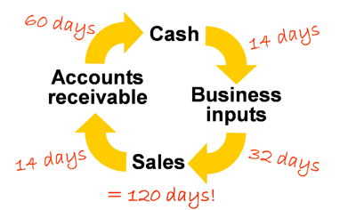
Financial Statements
How long is your cash cycle?

Slide 12
Financial Statements
Departmental Expense Reports
Measure spending vs benchmarks, typically budget & prior year
Accountability tool

Slide 13
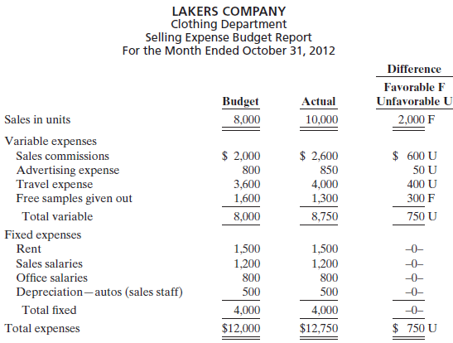
Financial Statements
Departmental Expense Reports

Slide 14
Financial Statements
Accounts Receivable Aging
Track slow paying customers
Manage cash
Accounts Payable Aging
Track future vendor payment obligations
Manage cash

Slide 15
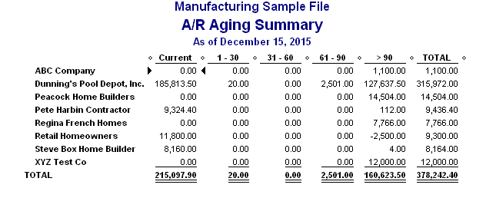
Financial Statements
Accounts Receivable Aging

Slide 16
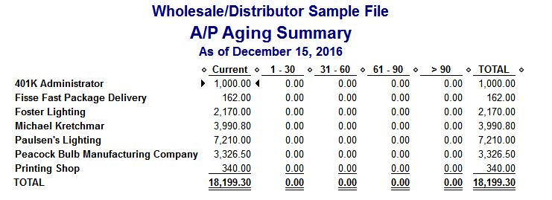
Financial Statements
Accounts Payable Aging

Slide 17
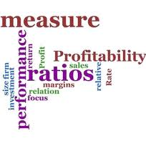
Financial Ratios
Common Size Ratios
Liquidity Ratios
Operating Ratios
Solvency Ratios

Slide 18
Financial Ratios
Common Size Ratios
Calculate each line item as a percentage of the total, which makes comparisons more meaningful.
Common Size Ratios from the Balance Sheet
Common Size Ratios from the Income Statement
Helpful in identifying trends

Slide 19
Financial Ratios
Liquidity Ratios
Measure your company’s ability to cover its expenses.
Current Ratio
Quick Ratio
Indicators of financial strength

Slide 20
Financial Ratios
Operating Ratios
Measure the efficiency of your company’s operations.
Inventory Turnover Ratio
Inventory Days on Hand
Accounts Receivable Turnover Ratio
Accounts Receivable Days on Hand
Accounts Payable Turnover
Accounts Payable Days
Cash Cycle
Return on Assets
Key indicators to management running the business

Slide 21
Financial Ratios
Solvency Ratios
Measure the stability of your company and its ability to repay debt.
Debt to Worth Ratio
Working Capital
Net Sales to Working Capital
Z-Score
Indicators of the company’s viability and financial health

Slide 22
Performance Metrics
Manufacturing Productivity (cost of production)
Pieces per hour
Yield & Waste
Machine Throughput
Sales per labor hour
Sales Inquiries (customer service department)
Calls per day
Conversion rate
Sales Productivity (sales force)
Sales per employee
Sales/wages paid
Turns (days)
Inventory
Receivables

Slide 23
Balance Sheet

Slide 24
Income Statement

Slide 25
About the Presenter
Patricia I. Lawrence, CMA – Principal, Turbo Execs
Patty works with results-oriented small and medium business owners who are struggling with financial chaos, such as out-of-control growth, sudden terrifying decline in revenues or profits, or people problems that are having a negative impact on the business.
She reveals the “story behind the numbers” with financial tools and systems that quickly skyrocket productivity and remove barriers to growth and profitability. As a result, her clients typically increase the bottom line by at least 15% and feel in control of their finances and results.
Patty got her first taste of entrepreneurial life in the office of her father’s well drilling business in her teens. With her first accounting class in high school, she’d found the professional outlet for her problem-solving skills.
In her free time, Patty enjoys playing competitive tennis. Her husband and two sons hope she’ll renew her old passion for baking again soon.
plawrence@ImplementationMG.com (717) 917-0342

Slide 26
About Turbo Execs
Driving Companies Toward Profitable Growth through:
Empowering Financial Systems
Eliminating HR Headaches
Engineered for Profits
Additional Executive Horsepower
In the midst of chaos, Turbo Execs get things back on track and put you in the driver’s seat. With more management horsepower for your business – when you need it.

